Slide 1

Learning the Speediness in Videos and Generating novel videos from a single sample
Sagie Benaim​ School of Computer Science, Tel Aviv University

Slide 2
Generate new and relevant content from a given video
SpeedNet: Learning the Speediness in Videos. CVPR 2020. with Ariel Ephrat, Oran Lang, Inbar Mosseri, Bill Freeman, Miki Rubinstein, Michal Irani and Tali Dekel.
speednet-cvpr20.github.io
Hierarchical Patch VAE-GAN: Generating Diverse Videos from a Single Sample. NeurIPS 2020. with Shir Gur and Lior Wolf.
shirgur.github.io/hp-vae-gan/

Slide 3
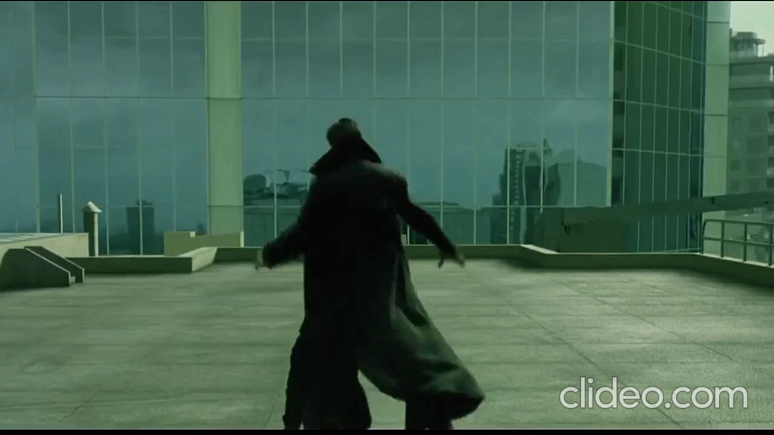
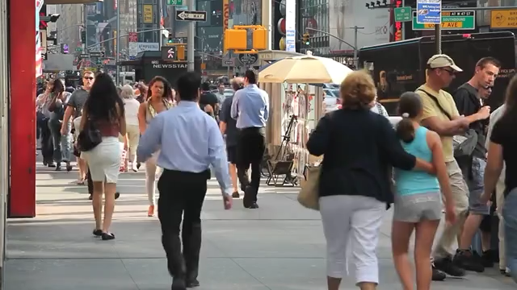
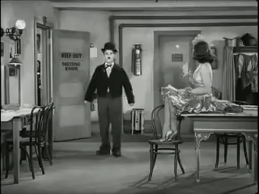
Automatically predict “speediness”
Slower
Normal speed
Faster
Notes:
When we watch a video, we can often easily tell the “speediness” of videos:
Whether videos are slower than normal speed <click> At normal speed <click> Or faster than normal speed <click>
We can do so because we know how objects such as people or cars move in the world and their natural rate of motion.
In this work, our goal is to automatically predict speediness in videos. But why is this a useful task to solve?

Slide 4
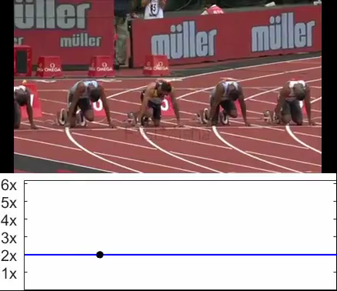
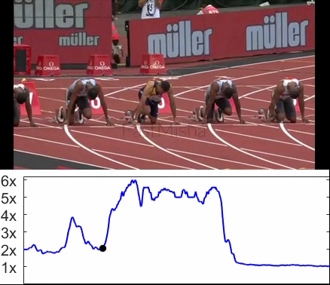
Automatically predict “speediness”
Uniform Speed Up (2x)
Adaptive speed up (2x)
Other Applications:
Self-supervised action recognition
Video retrieval
Notes:
Consider the task of taking an input video and speeding it up. <click>
On the left side, we speedup of a video of athletes sprinting, uniformly, at twice the original speed.
This results in undesirable and unnatural jittery motion. <click>
Our method can be used to <CLICK> adaptively change the speed rate based on the video content.
Here’s the same video sped up using our method based on speediness prediction. It has the same total duration as the previous uniformly sped-up one. <click>
As you can see it’s much more natural-looking <click>.
In addition to adaptive speedup predicting speediness gives rise to other applications such as <CLICK> self-supervised action recognition, and <CLICK> video retrieval.
Additional applications are provided in the paper.

Slide 5
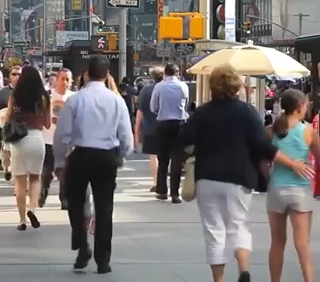
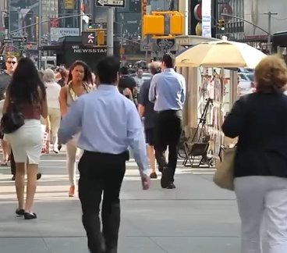
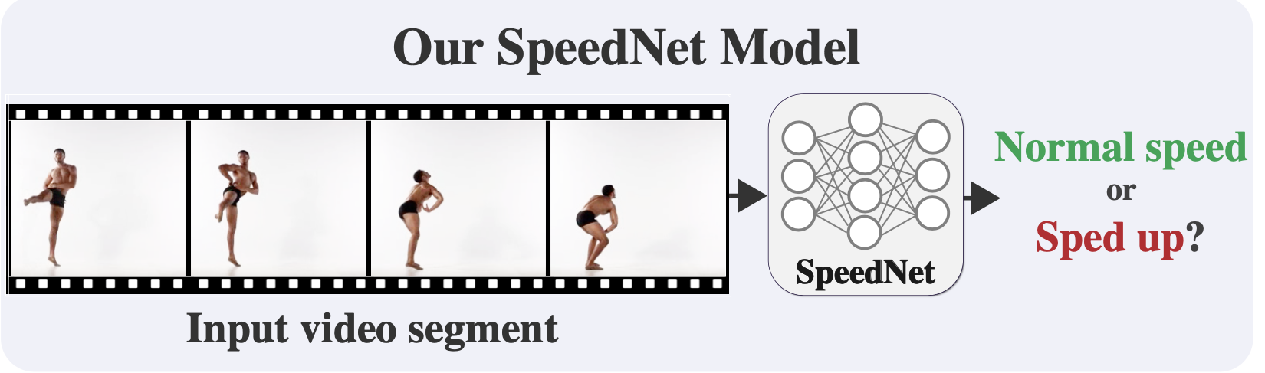
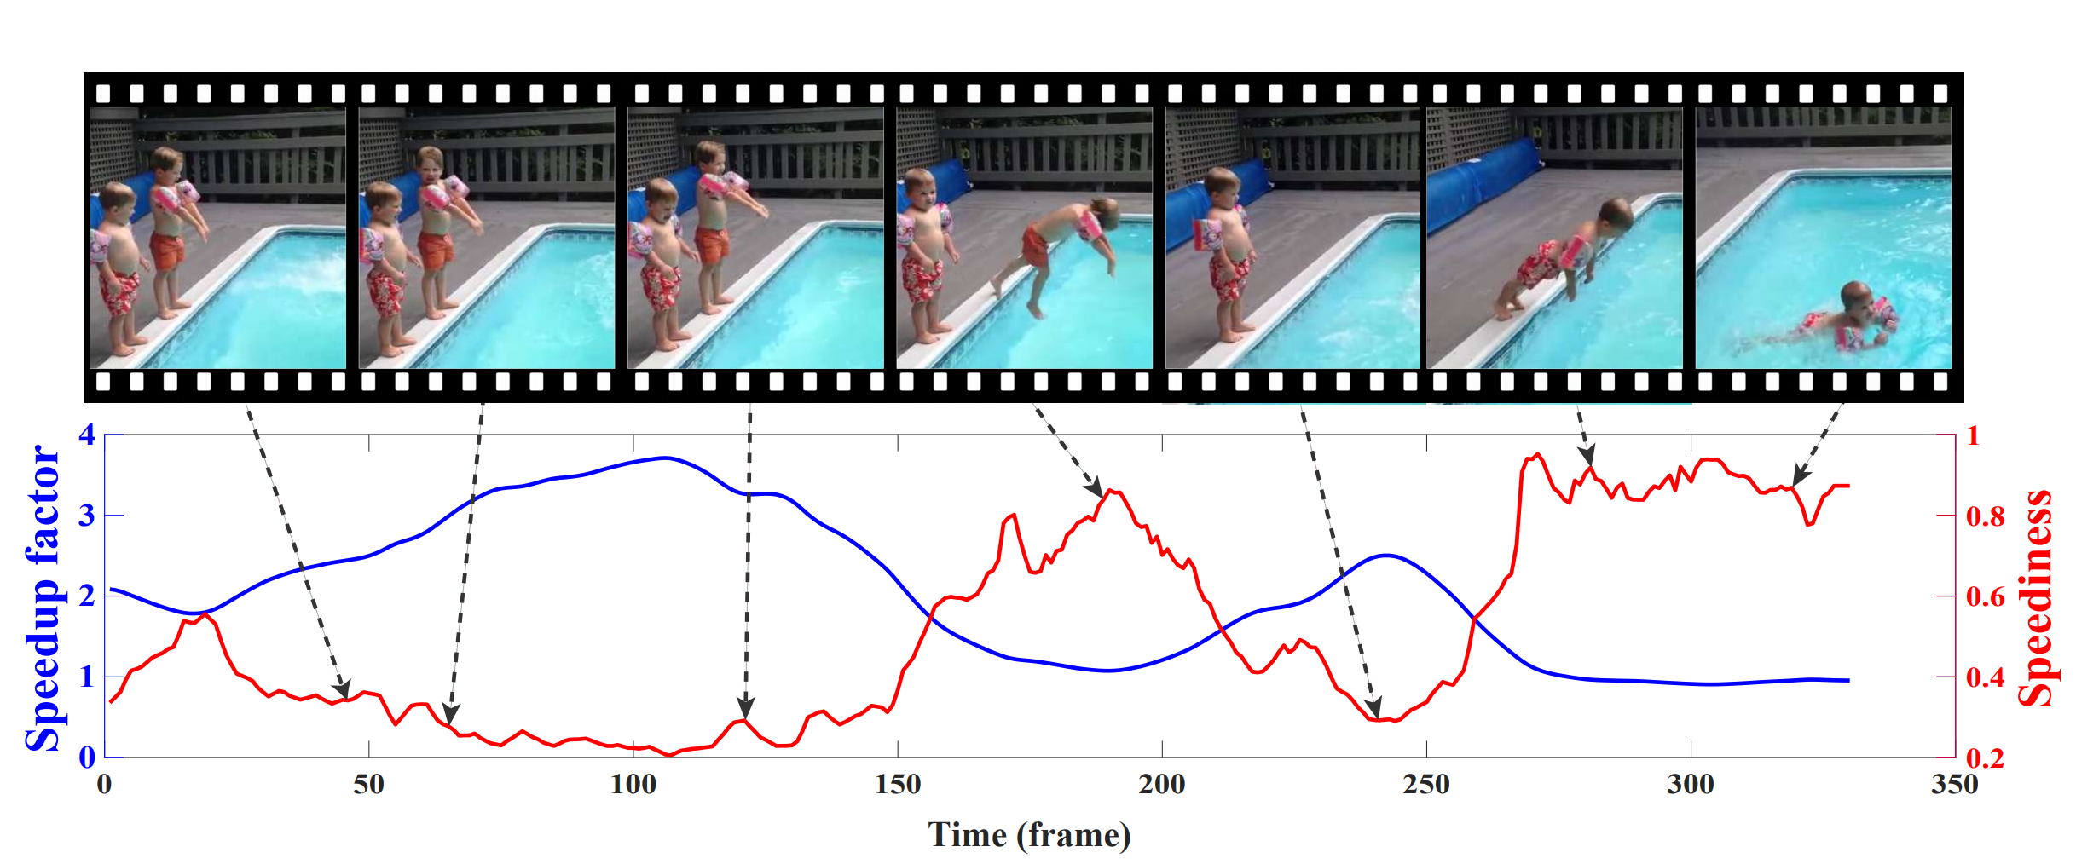
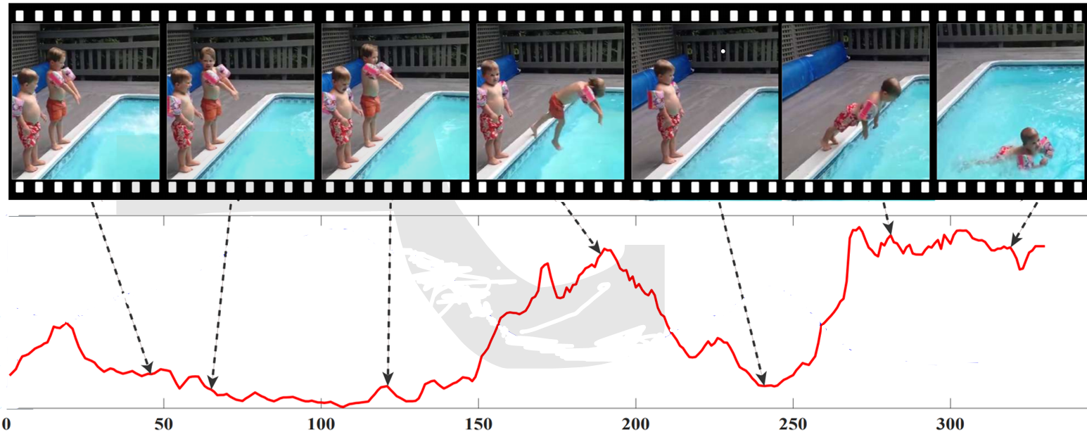
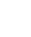
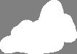
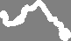
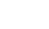
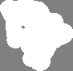
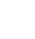
SpeedNet
Self-supervised
training
Sped Up
Normal speed
Input video
Inference on full sped-up video
Sped-up
Normal speed
Notes:
So how was this done?
We trained a network called “SpeedNet” <CLICK> to classify whether a given video clip <CLICK> [pause] is of normal speed <CLICK> or [pause] sped up <CLICK>.
We train our network on short video clips of 30 frames.
This is done in a <CLICK> self supervised manner with no manual annotations. <CLICK>
For normal speed videos, we played videos at their normal speed rate, and for sped up ones, we applied uniform speed up (up to some augmentations which I will later describe).
At inference time <CLICK>, given a video clip <CLICK> we run our model in sliding window fashion.
We do not expect our model to predict all timesteps perfectly, as some contain little-to-no motion.
As long as the network thinks that certain video parts are not sped-up, we can keep on speeding up those video segments even further.
This gives rise to our adaptive video speedup.

Slide 6
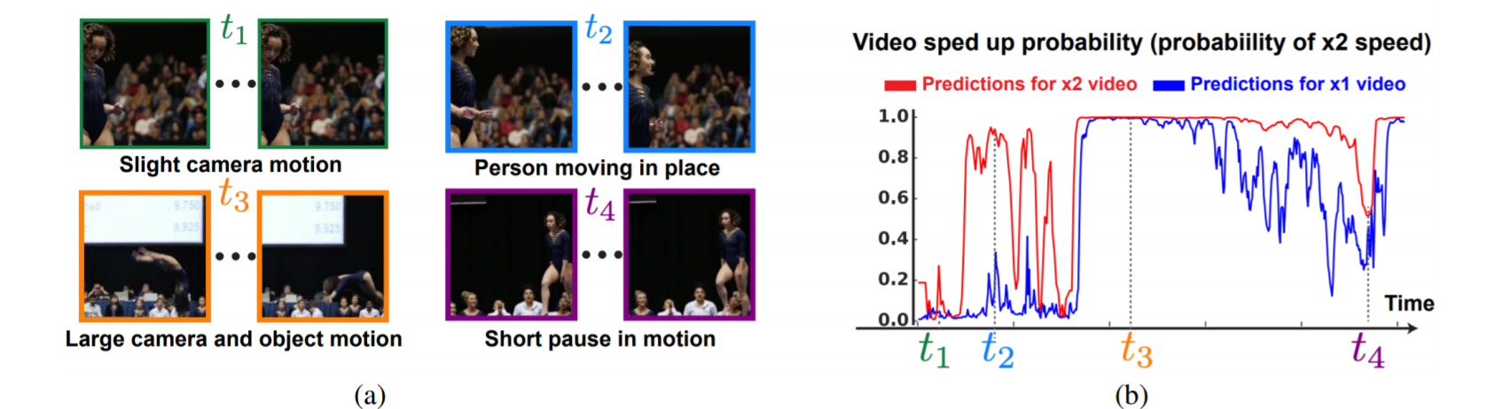
SpeedNet Predictions

Slide 7
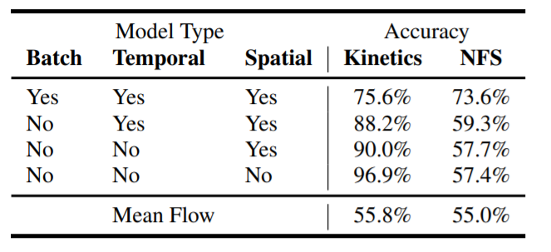
SpeedNet ≠ Motion Magnitude
A simple network trained with motion magnitude as input
Motion magnitude correlated with distance to camera
Input
Full Video

Slide 8
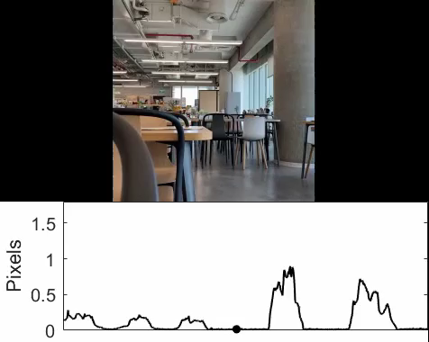
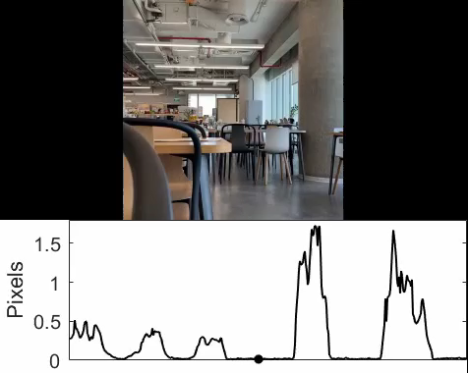
SpeedNet ≠ Motion Magnitude
Motion Magnitude (1x)
Motion Magnitude (2x)
Notes:
Here is a video of a person walking back and forth, at first further away from the camera, then closer to the camera. The magnitude of motions varies significantly throughout the sequence (in particular, the motions get larger when the person is closer to the camera).
<CLICK> The motion magnitude doubles when the same video is played at twice the speed.

Slide 9
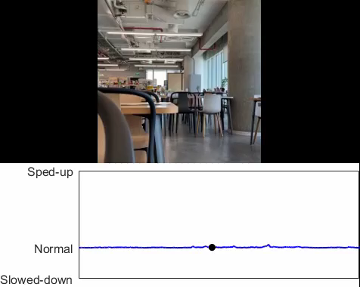
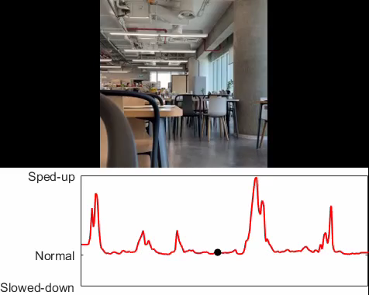
SpeedNet ≠ Motion Magnitude
SpeedNet (1x)
SpeedNet (2x)
Notes:
SpeedNet model is able to produce a stable classification of normal speed throughout the video (speediness score close to zero).
<CLICK> If we input to SpeedNet the video played at twice the speed (2×), then the walking segments do indeed get recognized as faster-than-normal human motions (higher speediness scores), whereas the static segments (no person in the scene), are classified as normal speed.

Slide 10
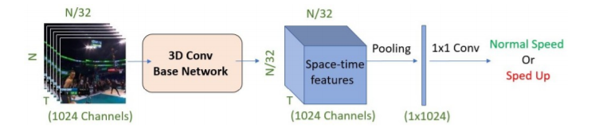
Training SpeedNet
N
(3 Channels)
Spatial Max Pooling
Temporal Average Pooling
Notes:
Our network architecture is largely based on S3D-G, a state-of-the-art action recognition model. There are a number of differences though, and I’ll describe and important one here.
Intuitively, we want the prediction to be determined by the most dominant spatially moving object, whereas temporally, we would like to take into account the motion through the entire video segment to avoid sensitivity to instantaneous “spiky” motions or to regions with no motion. We therefore reduce the spatial dimension by applying global max pooling, and reduce the temporal dimension by applying global average pooling.

Slide 11
`
Training SpeedNet: Artificial Cues
Spatial augmentations.
Temporal augmentations
Same-batch training.
Notes:
Previous work has shown networks have a tendency to use shortcuts—artificial cues present in the training data, to help them solve the task at hand. We perform a number of strategies to avoid them

Slide 12
Spatial Augmentations
Fully convolutional network
Random resize between 64 to 336
Blurring helps mitigate potential pixel intensity jitter caused by MPEG or JPEG compression
Notes:
Spatial: During training, we randomly resize the input video clip to various spatial dimensions. The blurring which occurs during the resize process can help mitigate potential pixel intensity jitter caused by MPEG or JPEG compression of each frame. After passing the input through the base network, we perform spatial global max pooling over the regions in the resulting space-time features. Since the input is of variable size, these regions correspond to differently sized regions in the original, unresized input. This forces our network not to rely only on size-dependent factors, such as motion magnitude.

Slide 13
Temporal Augmentations
Normal speed sample rate: 1-1.2x
Sped up sample rate: 1.7-2.2x
Randomly skip frames with probability 1 – 1/f where f is randomly chosen randomly in the desired range.
Notes:
Temporal: We would like to sample a video at either normal speed or twice its normal speed. To introduce variability in the time domain, for normal speed we sample frames at a rate of 1×-1.2× and for the spedup version we sample at 1.7×-2.2×

Slide 14
Same Batch Training
Both “normal speed” and “sped-up” version appear in the same batch
Similar to other Self-Supervised works such as “predicting image rotation”
Notes:
Same-batch training: each batch contains both normal-speed and sped-up versions of each video clip.

Slide 15
`
Training SpeedNet: Artificial Cues
NFS: Need For Speed dataset taken at 240 FPS
No “Shortcuts” – A gap of 2%
“Shortcuts” – A gap of > 28%
Notes:
To demonstrate the effect of these augmentations, we consider the effect of training without them.
When training SpeedNet without these augmentations, SpeedNet relies on these learned “shortcuts”–artificial cues that are present in Kinetics, which lead to a misleading high test accuracy. However, when tested on another held our dataset called NFS (Need for Speed), such cues are not present, and so the test accuracy drops to 57.4%. When using all of the augmentations, reliance on artificial cues is reduced significantly (accuracy drops from 96.9% to 75.6%), and the gap between the test accuracy of Kinetics and that of NFS drops to 2%, indicating better generalization.

Slide 16
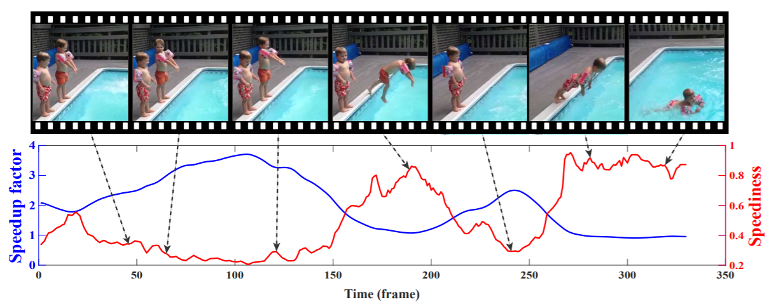
From Speediness to Adaptive Speedup
Original 1x video
1x video (T frames)
2x video (Interpolate to T Frames)
N videos of increasing speed
3x video (Interpolate to T Frames)
…
Nx video (Interpolate to T Frames)

Slide 17
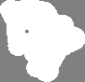
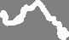

From Speediness to Adaptive Speedup
Speediness Curve
Sped-up
Normal speed

Slide 18
From Speediness to Adaptive Speedup
Original 1x video
1x video Speediness Curve
2x video Speediness Curve
N videos of increasing speed
3x video Speediness Curve
…
Nx video Speediness Curve

Slide 19
From Speediness to Adaptive Speedup
Original 1x video
Low Speediness (for most speedup curves)
1x video Speediness Curve
2x video Speediness Curve
N videos of increasing speed
3x video Speediness Curve
…
Nx video Speediness Curve

Slide 20
From Speediness to Adaptive Speedup
Original 1x video
High Speediness (for most speedup curves)
1x video Speediness Curve
2x video Speediness Curve
N videos of increasing speed
3x video Speediness Curve
…
Nx video Speediness Curve

Slide 21
From Speediness to Adaptive Speedup
Original 1x video
Medium Speediness (only some curves indicate speedup)
1x video Speediness Curve
2x video Speediness Curve
N videos of increasing speed
3x video Speediness Curve
…
Nx video Speediness Curve

Slide 22
From Speediness to Adaptive Speedup
Original 1x video
1x binarized video Speediness Curve
x1
2x binarized video Speediness Curve
x2
Speedup Vector V(t) = Max of
3x binarized video Speediness Curve
x3
…
Nx binarized video Speediness Curve
xN

Slide 23
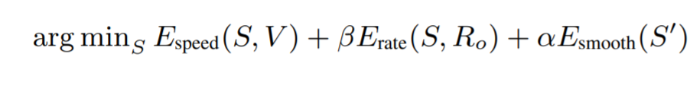
From Speediness to Adaptive Speedup
Original 1x video
Final step: Estimate a smoothly varying speedup curve
Espeed: S should be close to V(t) – our estimated Speedup Vector
Erate: The total frame rate should be the desired frame rate (e.g 2x or 3x)
Esmooth: Smoothness regularizer using the first derivatives S’

Slide 24
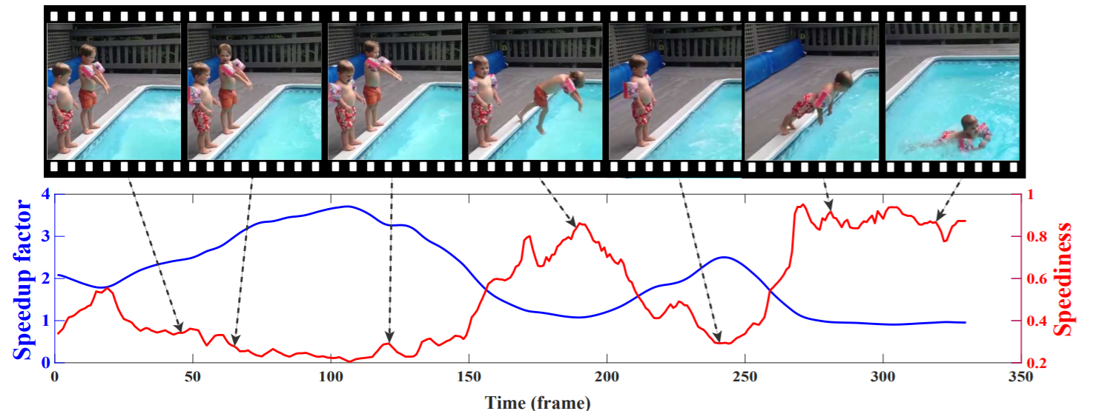
From Speediness to Adaptive Speedup
2x final “speediness curve” (blue):

Slide 25
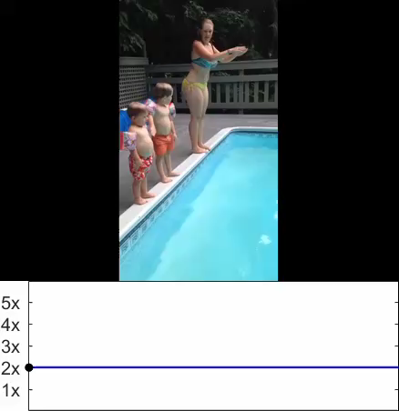
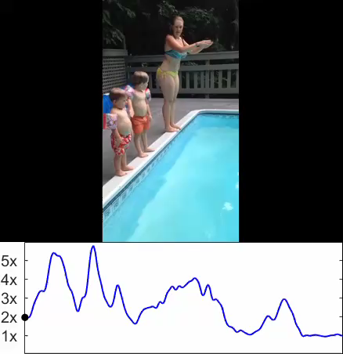


Adaptive video speedup
Total time = $\frac{1}{2}$ input time
Total time = $\frac{1}{2}$ input time
Speedup
Speedup
Time
Time
Uniform Speedup
Adaptive Speedup (ours)
Notes:
We can now use our speediness predictions to adaptively speed-up videos.
<CLICK> Here we can see video of a dancer was uniformly sped up by 2x, so it’s duration is half of the original duration.
<CLICK> On the right we used our adaptive speedup instead: Each segment in the video was sped up as long as SpeedNet determined the segment to be of normal speed.
Our result has the same duration as the uniformly speedup result, but is much more natural, and less jittery. <CLICK>
We performed a user study in which users preferred our adaptive speedup in all cases.

Slide 26
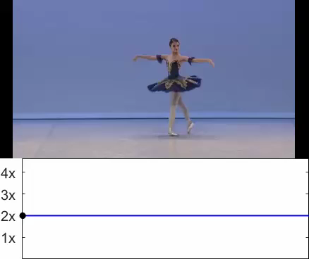
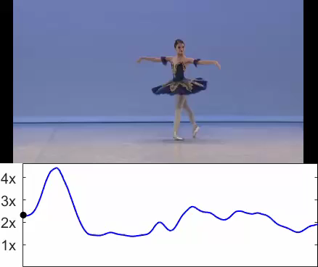

Adaptive video speedup
Total time = $\frac{1}{2}$ input time
Total time = $\frac{1}{2}$ input time
Speedup
Speedup
Time
Time
Uniform Speedup
Adaptive Speedup (ours)
Notes:
We can now use our speediness predictions to adaptively speed-up videos.
<CLICK> Here we can see video of a dancer was uniformly sped up by 2x, so it’s duration is half of the original duration.
<CLICK> On the right we used our adaptive speedup instead: Each segment in the video was sped up as long as SpeedNet determined the segment to be of normal speed.
Our result has the same duration as the uniformly speedup result, but is much more natural, and less jittery. <CLICK>
We performed a user study in which users preferred our adaptive speedup in all cases.

Slide 27
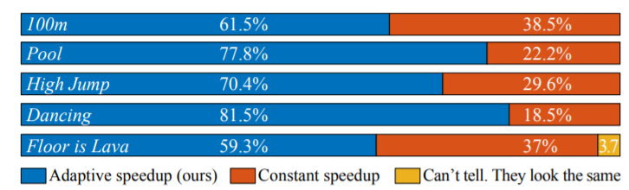
Adaptive Speedup Preferred in all videos of a user study

Slide 28
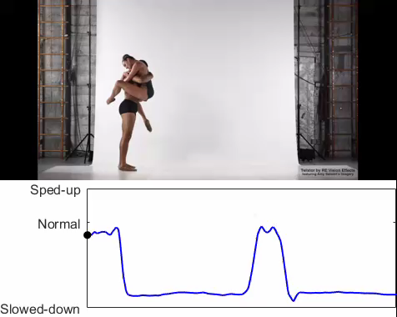
Generalization to Slowed Down Videos
Notes:
Our method can also be used to detect slowed down regions of a video, even thought it was not trained on such slowed down video segments. To emphasise, the detection is based on speediness and not motion magnitude, as I described earlier.

Slide 29
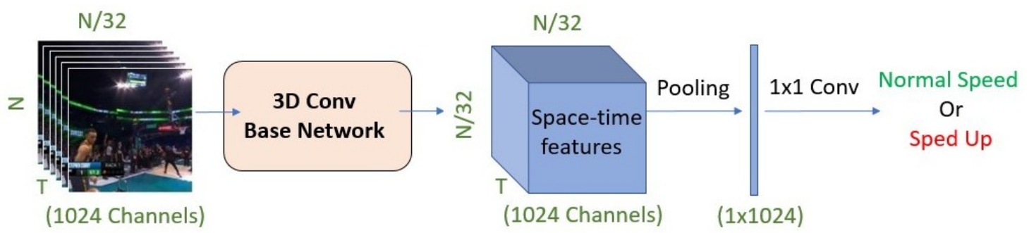
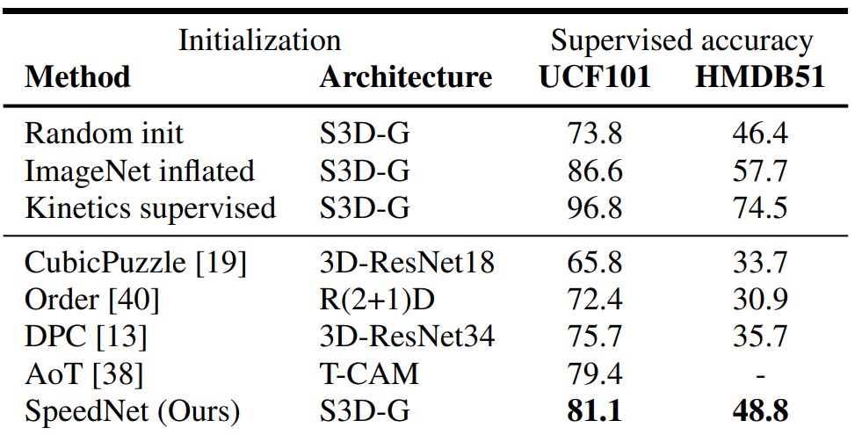
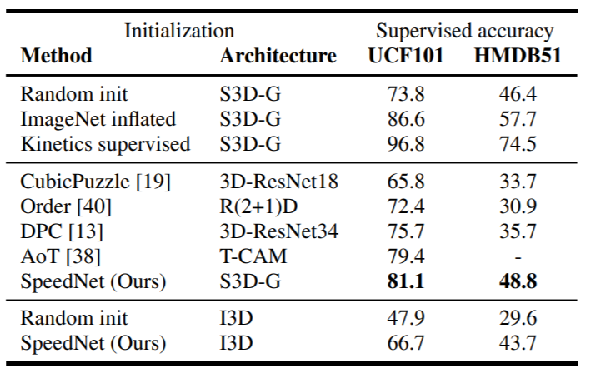
Other self supervised tasks
Train SpeedNet
Self Supervised Action Recognition
Notes:
SpeedNet can be used in other self supervised tasks <CLICK>. We first train SpeedNet on a large corpus of videos of Kinetics in a self supervised manner. <CLICK>
We then utilize the space-time representations SpeedNet learned <CLICK>, and finetune our model for action recognition <CLICK>. Our method beats all other models pre-trained in a self-supervised manner on Kinetics <CLICK>.

Slide 30
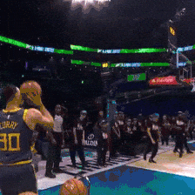
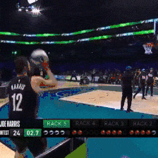
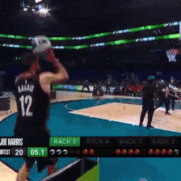
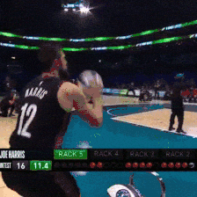
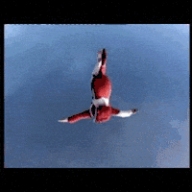
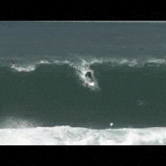
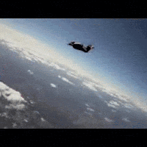
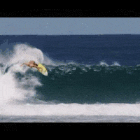
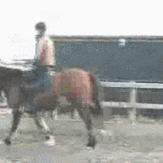
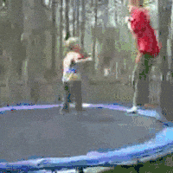
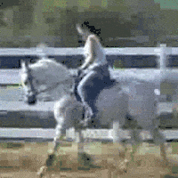
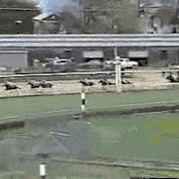
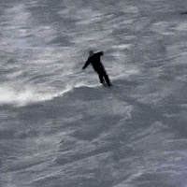



Other self supervised tasks:
Video Retrieval
Train SpeedNet
Query
Retrieved top-3 results (Within)
Query
Retrieved top-3 results (Across)
Notes:
Our model can also be used for video retrieval <CLICK>. We extract a SpeedNet embedding <CLICK> for the query clip <CLICK> , and find nearest neighbors in embedding space from within the same video <CLICK> or even for a query clip <CLICK> across videos <CLICK>.
Note that SpeedNet was not trained specifically for action recognition, so some of the neighbours are not of the same class, but contain similar motion patterns.
For example <CLICK> a person free falling in the sky has a similar motion patter to a person surfing. .

Slide 31

“Memory Eleven”: An artistic video by Bill Newsinger: https://www.youtube.com/watch?v=djylS0Wi_Io
Notes:
The following artistic youtube video was made by an artist names Bill Newsinger by combining together spatio-temporal regions taken at “normal” speed and other regions taken at slow motion.
We can use SpeedNet to detect speediness in both space and time.

Slide 32

Spatio-Temporal Visualizations
blue/green = normal speed
yellow/orange = slowed down
Notes:
Shown here is a visualization of SpeedNet’s predictions using class-activation maps -- blue or green regions are of “normal” speed, and yellow or orange regions are slowed down.
Notice how speednet detects spatiotemporal regions of slow motion and of normal speed.

Slide 33
Generate new and relevant content from a given video
SpeedNet: Learning the Speediness in Videos. CVPR 2020. with Ariel Ephrat, Oran Lang, Inbar Mosseri, Bill Freeman, Miki Rubinstein, Michal Irani and Tali Dekel.
speednet-cvpr20.github.io
Hierarchical Patch VAE-GAN: Generating Diverse Videos from a Single Sample. NeurIPS 2020. with Shir Gur and Lior Wolf.
shirgur.github.io/hp-vae-gan/

Slide 34






Video Generation From a Single Sample
Real
Generated Samples
13-Frames
13-Frames
Notes:
We consider the task of generating diverse and realistic videos given only a single video sample at train time.
Our training video and the generated video samples each consist of 13 frames.
On the left are the training videos and, on the right, our generated video samples.

Slide 35


Extending 2D to 3D
Real
Ours
Real
SinGAN [1] + 3D Convolution
Real
ConSinGAN [2] + 3D Convolution
[1] “SinGAN: Learning a Generative Model from a Single Natural Image”, Shaham et al., ICCV 2019
[2] “Improved Techniques for Training Single-Image GANs”, Hinz et al., arXiv 2020
Notes:
Recently, approaches to generate diverse images given only a single input image were proposed.
We consider SinGAN and a recently prosed extension called ConSinGAN.
To generated videos we used the natural extension of these techniques by replacing all 2D convolutions with 3D ones.
As can be seen, unlike our method, both SinGAN and ConSinGAN are prone to mode collapse and generate videos of inferior quality.

Slide 36

Proposed Approach: Patch VAE
Input video - $x^{0}$
Notes:
We briefly describe our approach. We first describe a Patch formulation of a Variational Autoencoder that operates on a single sample.
The input to the patch vae is a single video sample x0.

Slide 37
Proposed Approach: Patch VAE
Encoder – $E\left(x^{0}\right)$
Receptive Field R
Notes:
The video is then passed through and fully convolutional encoder E

Slide 38







Proposed Approach: Patch VAE
KL Loss – $z^{′}$
Each feature $z_{i} , i=\left[1…K\right], K=T×H×W,$
in the latent space is associated with a patch $ω_{i}$
$$z_{0}$$
$$T×H×W$$
$$z_{1}$$
$$z_{2}$$
$$z_{i}$$
Latent dim = $C$
Notes:
This results in a spatiotemporal feature map z’ whose spatiotempral dimension is T times H times W, which we done as K, each having C channels.
As the encoder E is fully convolutional each of the K features is associated with an input patch of the training input video, and is of dimension C.
We then regard each of the K features as an encoding of a separate training patch and apply a VAE KL loss on these encodings.

Slide 39
Proposed Approach: Patch VAE
Decoder - ${\overline{x}}^{0}$
Receptive Field R
Notes:
The second part of the patch VAE consists of a fully convolution decoder G_0 .

Slide 40
Proposed Approach: Patch VAE
Reconstruction loss
Notes:
G_0 attempts to reconstruct the input video, and in particular all of its patches, given feature map z’.

Slide 41


Proposed Approach: Hierarchical Patch VAE
Coarsest scale:
Low resolution
and frame rate
Finest scale:
High resolution
and frame rate
$x^{0}$ (Real)
$x^{N}$ (Real)
${\overline{x}}^{0}$(Generated)
${\overline{x}}^{N}$(Generated)
LEVEL $=0$
LEVEL $=N$
Notes:
We now describe our full approach which consists of an hierarchical structure. Our hierarchy starts at coarsest level 0 where the training video is of the lowest resolution and frame rate and move up to level N where the training video is of the highest resolution and frame rate.
We begin at level 0, were our formulation of the patch VAE is trained.
We start by down-sampling the input video to a low FPS and spatial resolution which we call x_0.
We then apply our patch VAE formulation as previously described.

Slide 42

Proposed Approach: Hierarchical Patch VAE
LEVEL $=0$
Notes:
We begin at level 0, were our formulation of the patch VAE is trained, as described earlier.
At this level we use x_0 which is a down-sampled version of the input video and is of low frame rate and spatial resolution.

Slide 43

Proposed Approach: Hierarchical Patch VAE
LEVEL $=0$
Notes:
We use a large receptive field with respect to image size and generate structural diversity, i.e., modify the scene composition, including the number of objects and their positions.

Slide 44

Proposed Approach: Hierarchical Patch VAE
Up-sampling block - ${\overline{x}}^{1}$
LEVEL $=1$
Notes:
Moving to level 1, we freeze G_0 learned at scale 0 and train an upsampling fully convolutional generator G_1 that takes as input the low resolution output of G_0 and upsamples it to a higher resolution. We keep training the encoder E using KL loss and use a reconscution loss between the output of G_1 and a higher resolution version of the input video x1.

Slide 45

Proposed Approach: Hierarchical Patch VAE
Hierarchical up-sampling up to ${\overline{x}}^{M}$
LEVEL $≤M$
Notes:
We continue this way for M levels reaching a higher resolution of output videos using our patch VAE formulation.

Slide 46

Proposed Approach: Hierarchical Patch VAE GAN
Up-sampling block ${\overline{x}}^{M+1}$
LEVEL $=M+1$
Notes:
After training M levels of the hierarchy using our patch VAE formulation we move to use a patch GAN formulation.
We apply a similar reconstruction loss to that in the VAE formulation.
We use a small receptive field with respect to image size and introduce fine textural details. We encourage quality over diversity, which patch-GAN does well.

Slide 47

Proposed Approach: Hierarchical Patch VAE GAN
Adversarial training
Added noise $z_{M}$
LEVEL $=M+1$
Notes:
In addition, given a random noise z_M, we use adversarial training to generate novel samples at this scale.
Similarly to previous works we use a patch discriminator D to discriminate between real and fake patches of the video.

Slide 48

Proposed Approach: Hierarchical Patch VAE GAN
Hierarchical up-sampling up to final resolution ${\overline{x}}^{N}$
$M+1<$ LEVEL $≤N$
Notes:
We continue this way adding more upsampling patch-GAN blocks until the final level N.

Slide 49




Effect of Number of patch-VAE levels
Training Video
9 Levels Total
1 p-VAE – 8 p-GAN
8 p-VAE – 1 p-GAN
3 p-VAE – 6 p-GAN
Notes:
We now demonstrate the effect of using a different number of patch VAE levels compared to patch GAN levels.
Consider the above training video of hot air ballons.
<CLICK> Using 1 level of patch vae and 8 lavels of patch GAN results in mode collapse.
< CLICK> One the end of the scale, using 8 levels of patch vae and only one of patch GANS results in significant diversity, but very low quality.
< CLICK > Using 3 levels of patch VAE and 6 of patch GAN results in the right balance with both good diversity and quality.

Slide 50

Effect of Number of patch-VAE levels
Total of 9 layers
Quality
Diversity
(Lower is Better)
(Higher is Better)
Notes:
This can also be demonstrated numerically.
Increasing the number of patch-VAE levels and thus decreasing the number of GAN levels results in improved quality but inferior diversity.
<CLICK> Using 2 to 6 patch VAE levels, out of a total of 9, results in both improved quality and improved diversity compared to baselines methods.

Slide 51
Thank you!
Thank You
Much more at:
speednet-cvpr20.github.io and
shirgur.github.io/hp-vae-gan
Notes:
For more details and many more examples, please see our paper and website.

